Slide 1
Demo Apps for Visual Studio 2015

Slide 2

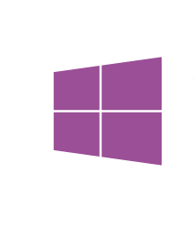


Focus areas for Demo Apps
Web and Services
IoT
Cloud Services
Cross- Platform Mobile
Big Data
Microsoft Mobile Platform
IoT devices
Security
LOB
Integration
Cloud First
Core platform
Mobile First
What’s new in the .NET 2015
Platform, core and languages
VS 2015 Tooling news
Desktop Apps

Slide 3
Focus areas for Demo Apps
Cloud First
Web & Cloud services
Azure Mobile Services
Big Data
HDInsight
Hadoop
Azure Websites
Azure Intelligent Systems
Azure
Redis cache,
DocumentDB
SB, …
IoT Cloud Services
Azure Active
Directory
Connected Services API
Enterprise Security
LOB Integration
O365
SalesForce
Cloud First

Slide 4

Focus areas for Demo Apps
Mobile First
Xamarin
VS Tooling for Cordova
Universal
Windows Apps
C++
Portable library
Client Agent of Azure Intelligent Systems Service
.NET
Micro Framework
and embedded
systems
Mobile First

Slide 5

Notes:
New logo

Slide 6


Suite of apps
MyShuttle is a B2B highly scalable multitenant SaaS solution that targets corporate scenarios in which carrier companies offer transport services to enterprise customers
Carrier Companies
MyShuttle
B2B Hub/marketplace
Enterprise customers/ employees
Agreement and carrier registration
Provide Service thru vehicle driver app
Vehicle fleet analysis
Carrier Dashboard
Multitenant
Highly scalable
Any platform
Agreement and enterprise customer registration
Employees use the transport service with any carrier in the hub

Slide 7



Mobile First, Cloud First scenarios
My Shuttle
Public Web (ASP.NET 5 MVC)
Carriers admins.
Enterprise customer admins.
Carriers admin web SPA
Salesforce API
Angular.js, jQuery
Office 365 API
Off-Line Desktop
Vehicles Garage control app
Services
Customer dashboard
Azure
Web Job
C# Universal app
WPF Desktop app
Azure Web Sites
ASP.NET 5
Web API
Services
Vehicle drivers
Enterprise employees
App for drivers
Azure Push
Notifications
Apps for customers
Cordova hybrid app (HTML/JS)
Azure
Mobile
Service
(Web API)
C# native apps
.NET
Xamarin
SQL

Slide 8









IoT and Big Data scenario
Carriers Admins
- Windows Store app Dashboard analysis
- PowerBI / PowerView
Warnings/Notifications
Big Data Azure HDInsight
and Azure DocumentDB
Vehicle Drivers
IoT Devices and sensors
IoT Cloud Services
.NET MF Devices
Raspberry Pi devices

Slide 9
Demo Apps

Slide 10
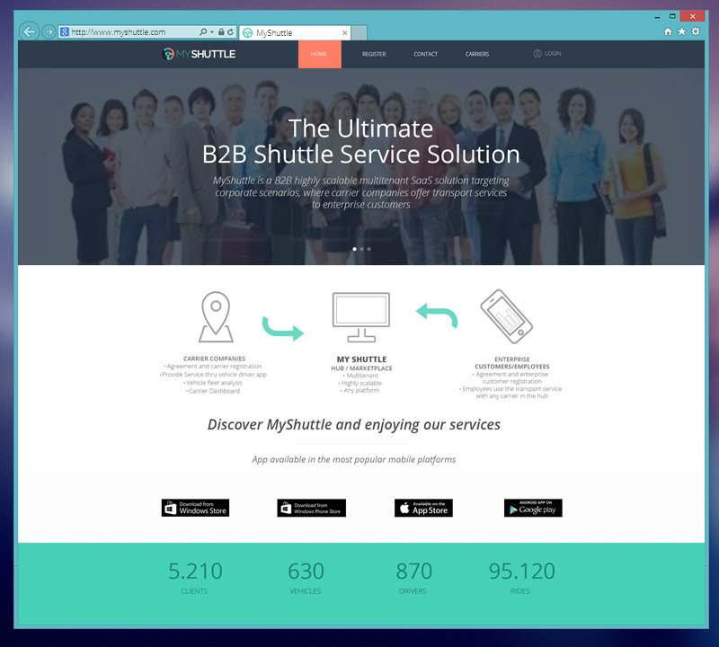
Public Web App
Technologies
ASP.NET 5 MVC
Entity Framework 7
Bootstrap
SQL Server
Responsive Home page
Gulp, bower

Slide 11
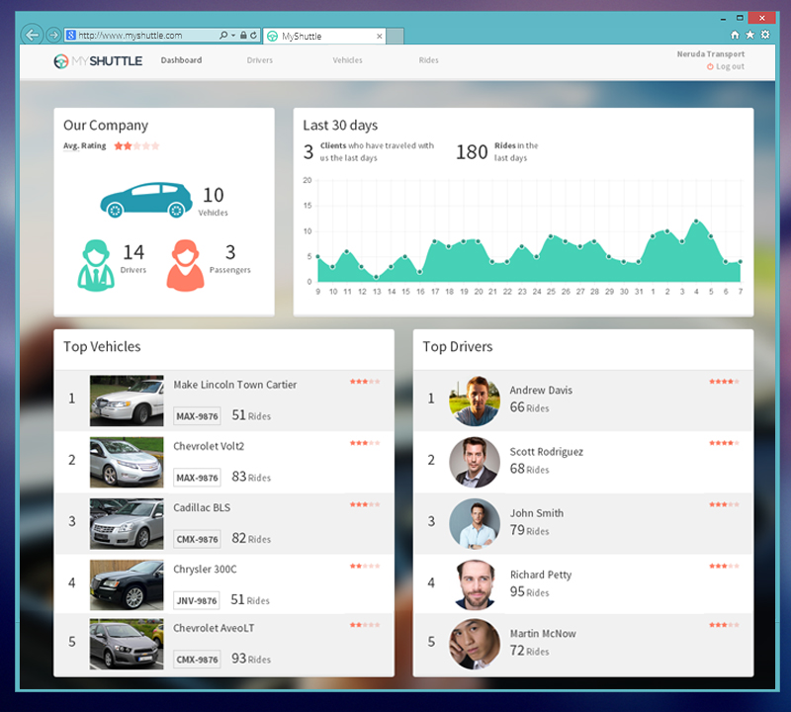
Private Web App for carriers
Technologies
SPA (Single Page Application) approach
Web API (ASP.NET 5)
Entity Framework 7
Angular.js, Bootstrap, LESS
Gulp, bower

Slide 12
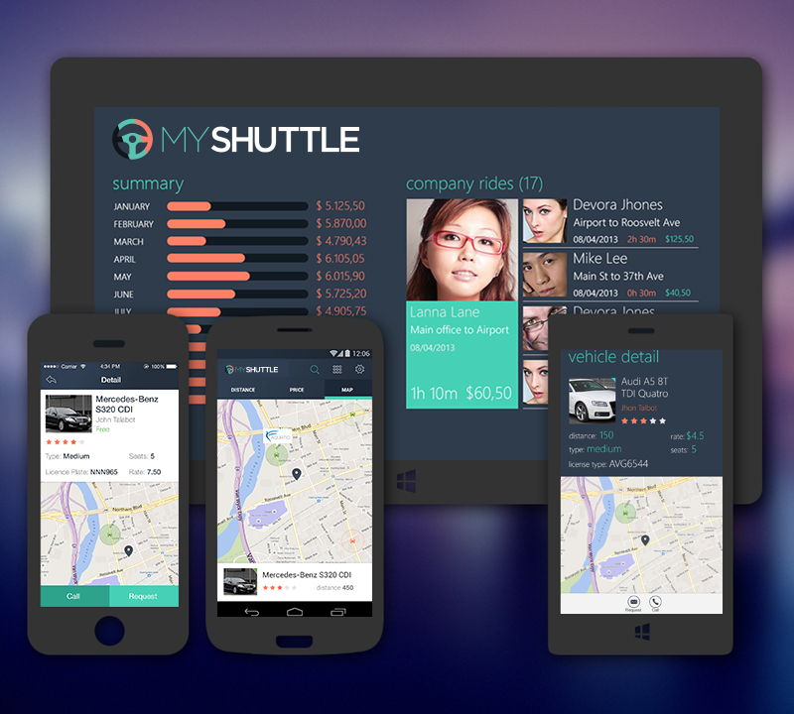


Native Cross-Platform Mobile apps for Enterprise Customers
Windows Store
Windows Phone
Technologies
Native mobile apps development
C# cross-platform
Xamarin powered
iOS and Android support
C++ MDD Library in Android Xamarin app
Universal Windows apps with C# and .NET

Slide 13
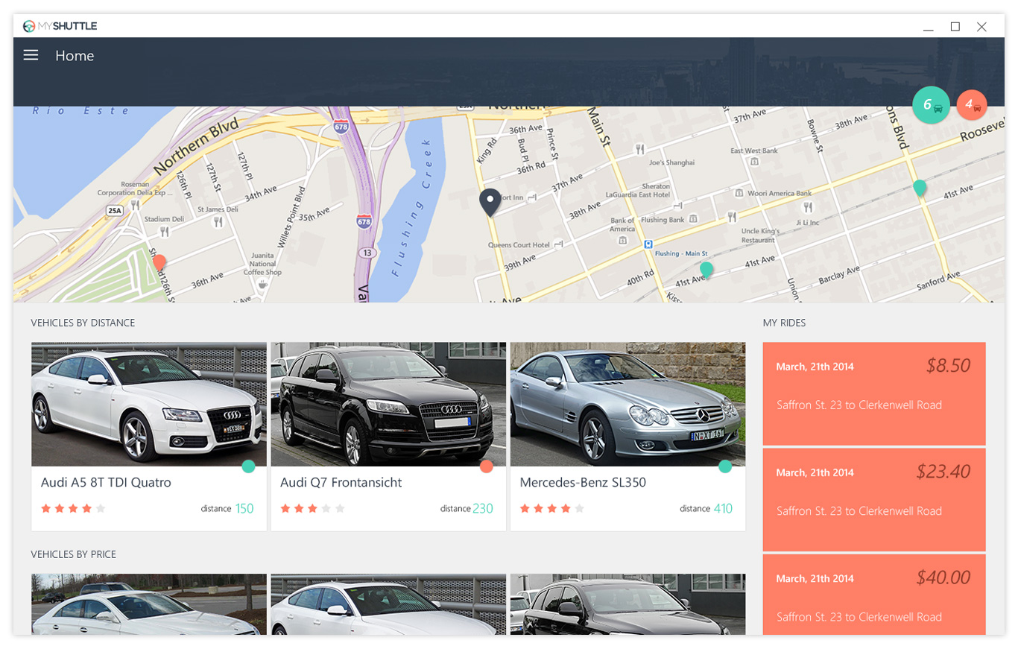
Windows Store
Universal Windows apps
Windows 10
Desktop
Windows Phone

Slide 14
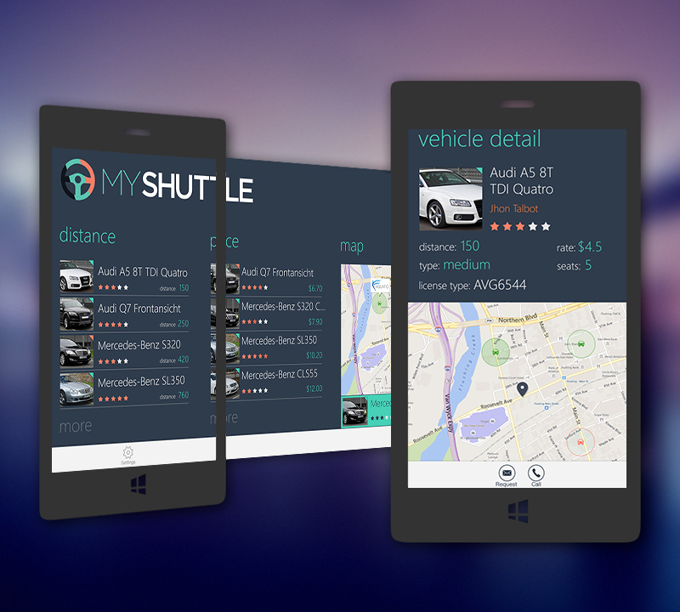
Windows Phone
Universal Windows apps
Windows Phone 10

Slide 15
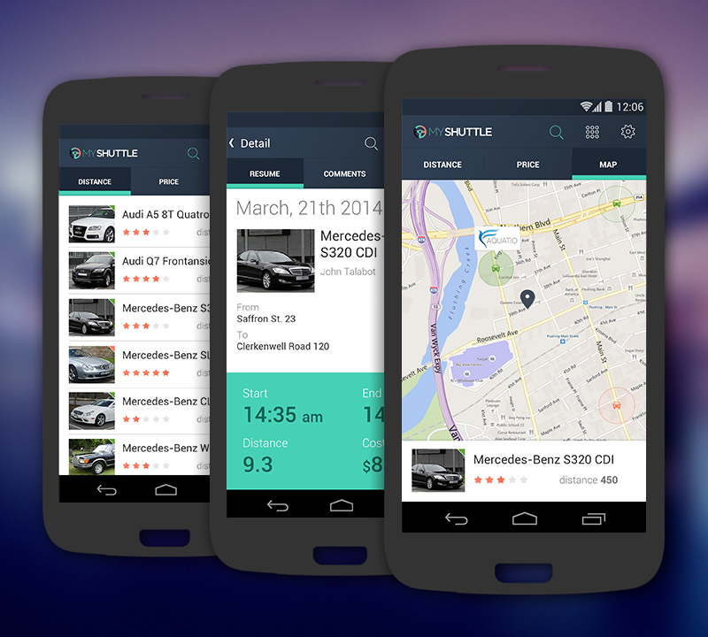
Android Phone
Xamarin/C# powered
Any Android vendor

Slide 16
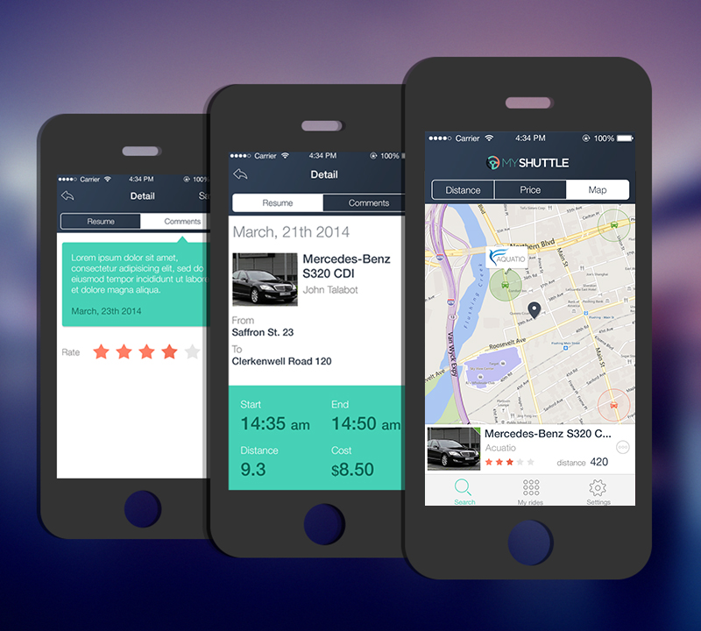
iOS Phone
Xamarin/C# powered
iPhone

Slide 17
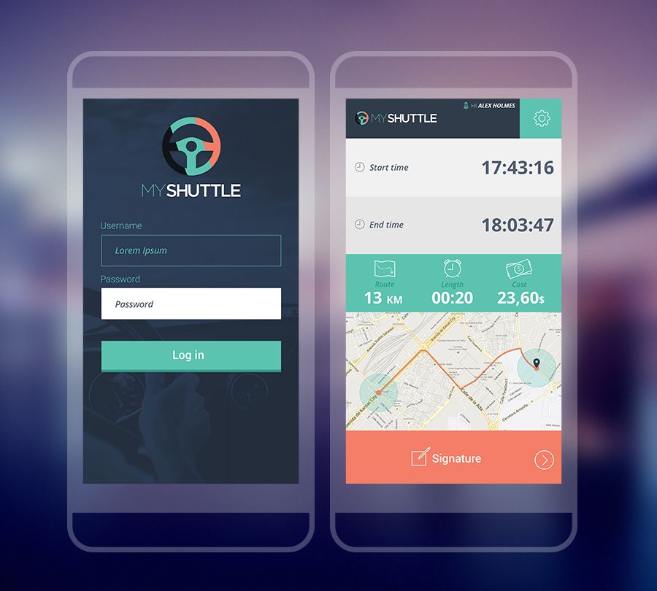


Hybrid mobile apps for vehicle drivers
HTML/JavaScript
Apache Cordova
Visual Studio Tools for Apache Cordova
Any device
iOS
Android
Windows Store / Windows Phone

Slide 18
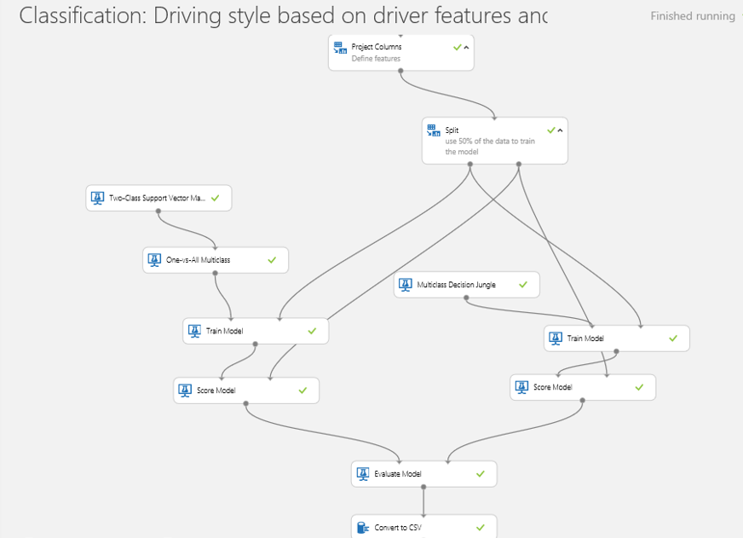
IoT and Big Data scenario
Event Hub
Stream Analytics
HDInsights
DocumentDB
DataFactory
Machine Learninng

Slide 19


